Slide 1
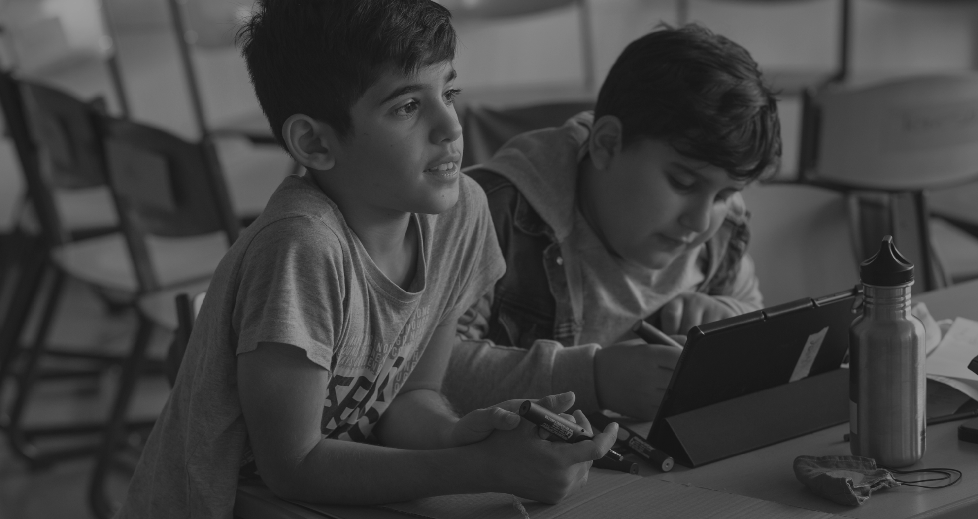
Being a Buddy Course:
TEACHER PRESENTATION FOR 3 SESSIONS
This powerpoint presentation works in tandem with Being a Buddy Course Booklet
The 3 x 15 min sessions can be done during lunch times or after school

Slide 2
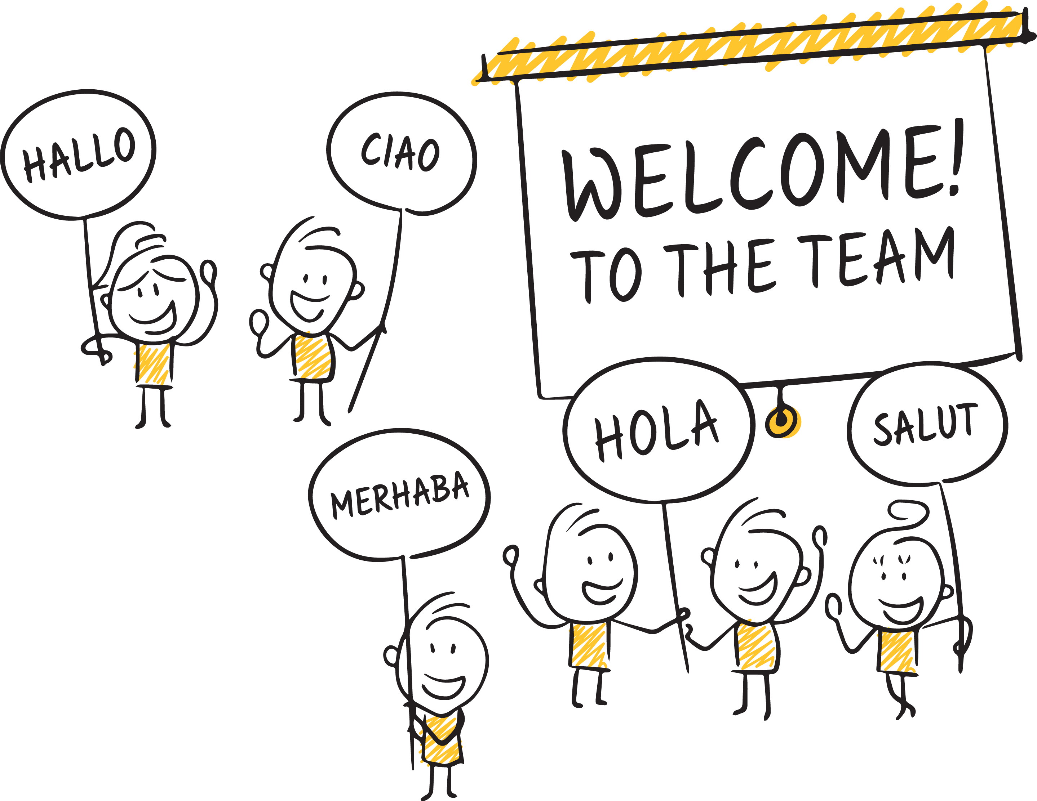
Welcome to the Being a Buddy Course
For applying to be a Buddy.
On your successful application!
Notes:
Welcome and thank the students.
Congratulate the students on their successful application.

Slide 3
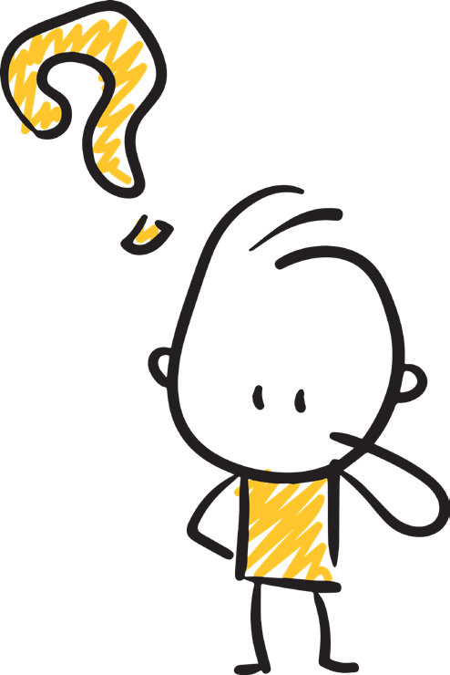
Being a Buddy Course – Session 1
What makes someone a good buddy?
Discussion:
Can you think of someone who has been a good friend or buddy in the past?
What made them a good buddy?
Notes:
Teacher can lead discussion by giving own example.
Students can work in pairs or trios and discuss the question.
Students share and report back.
Students may complete the corresponding page in their Being a Buddy Course Booklet in class or at home.

Slide 4
Being a Buddy Course – Session 1
Activity:
Lets think of the qualities of a good Buddy.
helpful
friendly
encouraging
understanding
patient
responsible
kind
a good listener
sympathetic
take turns
Notes:
Students come up with their own answers and fill this section in their booklets.
or
Do a Diamond 9 Ranking Activity with qualities and record them in the booklets.

Slide 5
Being a Buddy Course – Session 1
Home Task:
Why do you think you would make a good Buddy?
Find three synonyms for the word: Buddy
1.
2.
3.
Notes:
Ask students to complete this section on their own for the next session.

Slide 6
Being a Buddy Course

Slide 7
Being a Buddy Course – Session 2
How does it feel to be new to school or a group?
Discussion:
What questions could be going through their minds?
How would they feel? How would you feel?
Notes:
Students discuss the question and complete corresponding sections in their booklets.
***View and share the resource below to with your students, if you feel appropriate:
https://www.unicef.org/media/56661/file - The United Nations Convention on the Rights of the Child. PDF to be copied and handed out.

Slide 8
Being a Buddy Course – Session 2
Activity:
What could make your buddy sad?
Notes:
Discuss and students complete this section in their booklets.

Slide 9
Being a Buddy Course – Session 2
Home Task:
Always Do!
Definitely Don’t!
1.
1.
2.
2.
3.
3.
4.
4.
5.
5.
Notes:
Explain the task for students to complete before the third and final session.

Slide 10
Being a Buddy Course

Slide 11
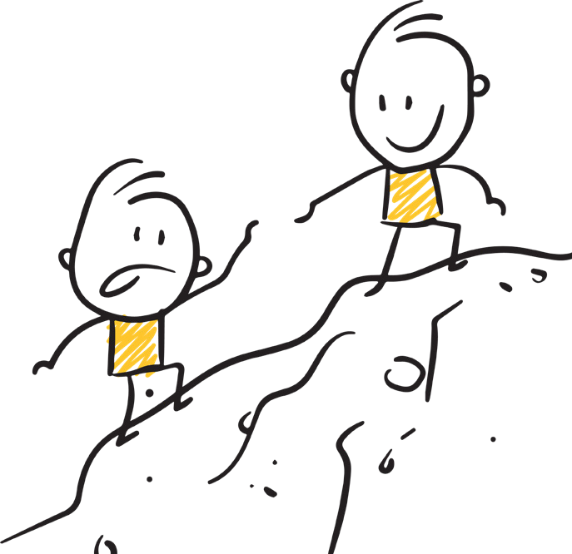
Being a Buddy Course – Session 3
What can I do to be a good Buddy?
Discussion:
What should my attitude be?
Top Tip: Always show respect!
Notes:
Students fill in notes in their booklet.
***Carefully select from the resources below to share with your students, if you feel appropriate:
https://www.bbc.co.uk/teach/school-radio/assemblies-ks2-diversity-difference-prejudice/z3f6qfr – A video on diversity
https://www.youtube.com/watch?v=_qtpmi4yzSs - Ted Talk on Respecting the differences between people
https://www.equalityhumanrights.com/en/equality-act/protected-characteristics - Video for Secondary Schools You are protected under the Equality Act 2010 from these types of discrimination.

Slide 12
Being a Buddy Course – Session 3
Activity:
Tips on making conversation
Questions I could ask:
Phrases I could learn, if my Buddy speaks another language:
■
■
■
■
■
■
■
■
■
■
Find out how to pronounce their name correctly. What is your name?
How do I say it? How old are you?
When is your birthday?
What is your favourite subject? What was your old school like?
What is your favourite food? What are your hobbies? Do you like sport?
Do you like animals?
■
■
■
■
■
Hello … Goodbye… My name is …
How are you ?
What do you call this ? How do you say this word?

Slide 13
Being a Buddy Course – Session 3
Activity:
Tips for being a great Buddy to anyone
✔
Smile often.
✔
If you want to know if they are ok show thumbs up or down.
✔
When you see someone struggling, ask if you can help them.
✔
Use your communication fan if you have one.
Notes:
Ask for ideas from the students.

Slide 14
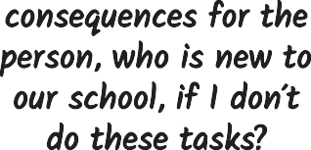
Being a Buddy Course – Session 3
What will my responsibilities be?
Meet them at the office on their first day.
Point out hanging and storage areas for our coats and bags.
Give a tour of the school.
Make sure they know where the toilets are.
Share the school rules with them.
Introduce and include them in my friendship groups.
Encourage them to speak to other students, who may speak the same language.
Be a friend at break time.
Take them to lunch and eat together.
Show and help them to record homework.
Remind them about homework, when to bring our PE kits, trips etc.
Always say where you will meet them.
***REPORT ANY CONCERNS TO A TEACHER STRAIGHT AWAY. IF YOU ARE WORRIED ABOUT ANYTHING TELL AN ADULT YOU TRUST IN SCHOOL.***
Notes:
Talk through responsibilities and then for students to think about the consequences and the effect on the new student should they not carryout their responsibilities effectively.

Slide 15
Being a Buddy Course – Session 3
I understand my responsibilities for being a good buddy to newcomers to our school.
I will do these tasks, to the best of my ability, to make our school a friendly and welcoming place to be.
Name: Date: Signature:
Notes:
Students sign the agreement.

Slide 16
Being a Buddy Course – Session 3
Notes:
Congratulate and explain next steps. Make sure students know that you are there to support them in their new role and that they must report any concerns.
Hand out any certificates if you have made any.

