Slide 1
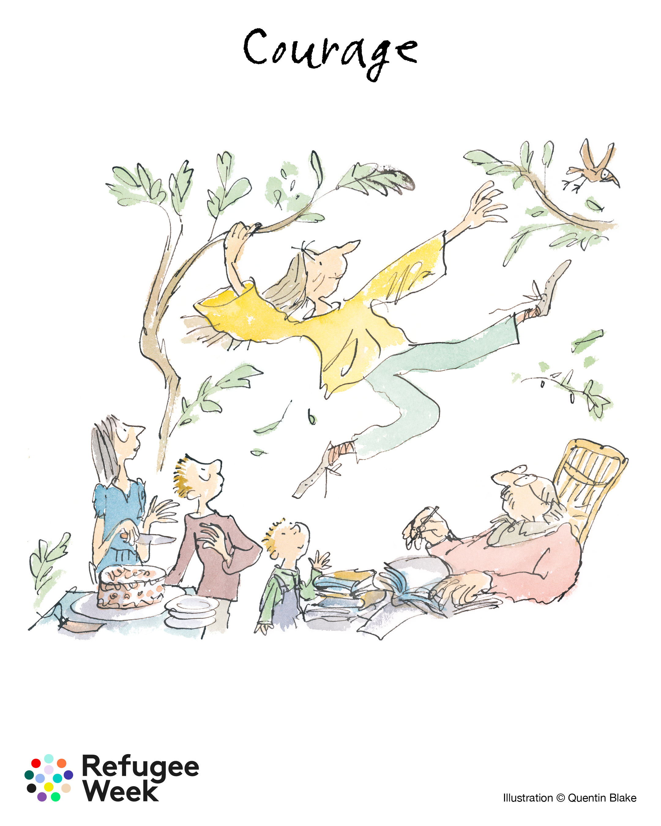


Notes:
Key aspects of the 2026 theme include:
Celebrating Courage: Recognizing the courage of people seeking sanctuary through stories and community action.
Simple Acts: Encouraging daily acts of connection, such as having a "courageous conversation".
75th Anniversary: Marking 75 years of the Refugee Convention (1951-2026).
Core Pillars: The theme focuses on courage in everyday acts, such as navigating new systems, learning new languages, and creating art

Slide 2

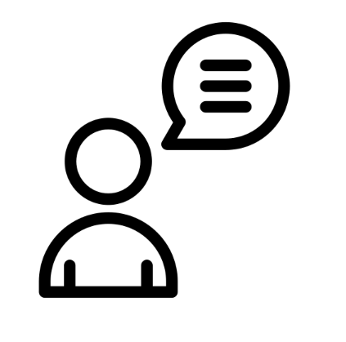

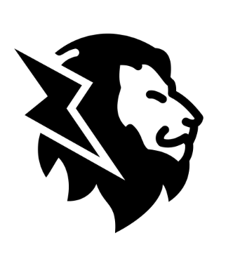
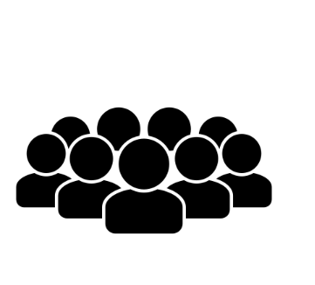
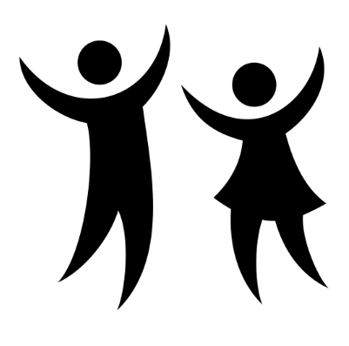
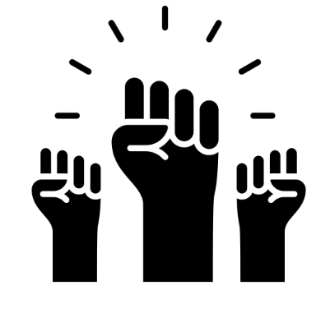
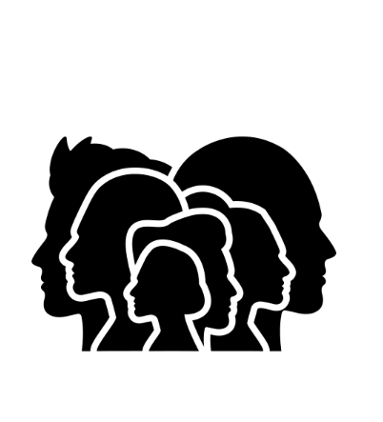
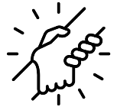
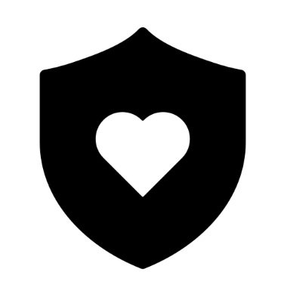
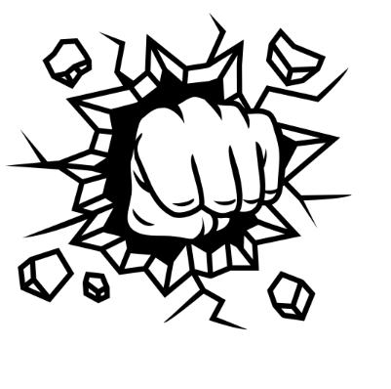

What does mean to you?
Notes:
Use the graphics as a stimulus
The word courage comes from the Latin cor, meaning “heart.”
Inspired by the lives and experiences of people seeking sanctuary, Refugee Week 2026 invites us to explore the theme of Courage.
For refugees around the world, courage is often a daily necessity. It is the courage to face unknown journeys, learn new languages, navigate unfamiliar systems, or simply to wake up each morning and step into an uncertain world.
At a time when some seek to divide and blame, Refugee Week 2026 calls us to come together and share the courage to welcome, to stand for what we believe in, and to celebrate culture and community – to be joyful, imagine new possibilities, dream, heal, and connect.
Courage isn’t always loud or bold. It can be found in simple acts: opening your door to a neighbour, trying new food, reading a book, or watching a film that changes your view of the world. It can be speaking up, asking for help, sharing your story – or simply having the courage to be yourself.
Through art, stories, and community, we celebrate the courage that lives within us all – and how connection helps it grow.

Slide 3
What is courage ?
The Oxford Learner's Dictionary’s definition of Courage:
‘The ability to do something dangerous, or to face pain or
opposition, without showing fear; it is defined as bravery.
It often signifies the strength of mind to carry on in spite of
danger, pain, or difficult circumstances.’

Slide 4
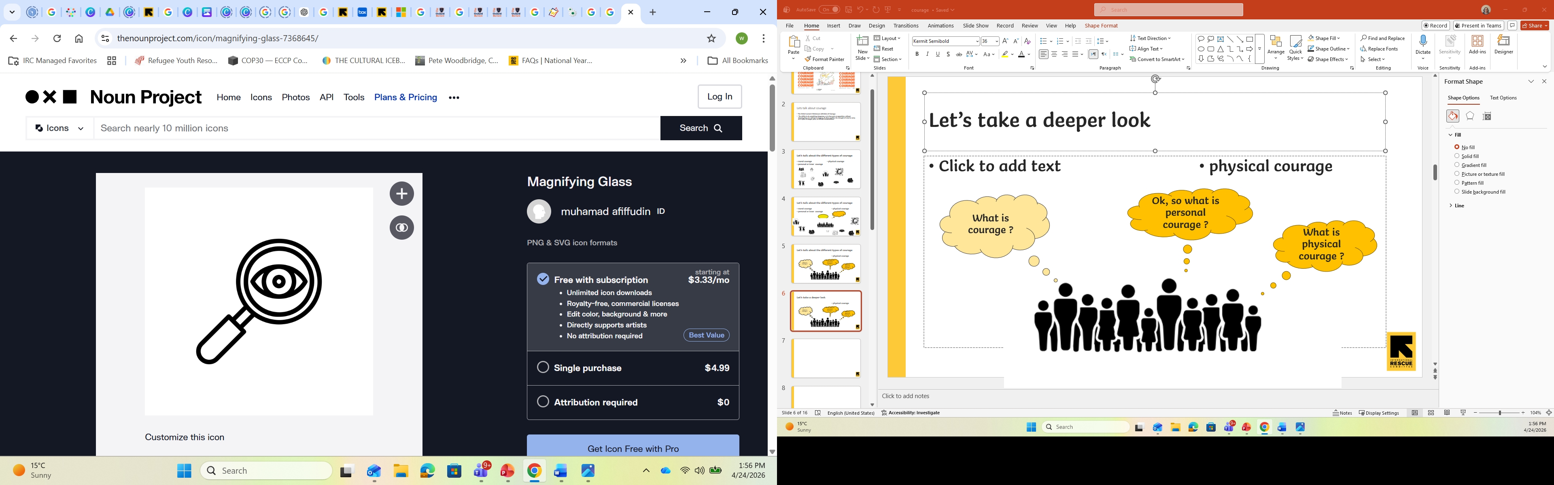
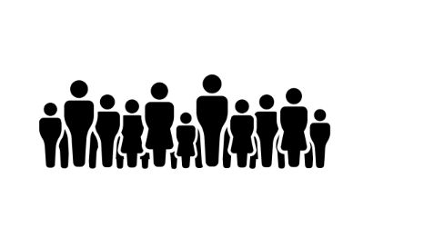
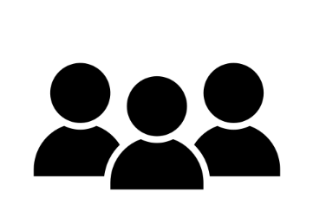
Let’s take a deeper look…
What is
physical courage ?
What is
personal courage?
What is
moral courage ?
I think …
It could be …
For me it means …
I’m not sure…
Is there a difference ?
Notes:
Learners share thoughts on the differences between the three types of courage

Slide 5


Let’s talk about
The Oxford Learner's Dictionary’s definition of COURAGE:
Personal courage being brave enough to try new things, do the right thing, or handle difficult
situations, even when we feel scared, nervous, or uncomfortable. It is not about having no
fear, but rather pushing through fear to act, learn, and grow.
Physical courage, is about facing a challenge with your body. For example, learning to ride a
bike, trying a new game, or jumping into the pool. If something doesn’t work, you try again!
Moral courage means being brave enough to do what is right, even when it feels scary
or hard. It is about speaking up and taking action when something is unfair or wrong.
Sometimes, this can be difficult because others might disagree, criticize, or leave you out.
It means standing up for fairness honesty, and doing the right thing, no matter what
others may think.
The ability to do something dangerous, or to face pain or opposition, without showing
fear; it is defined as bravery. It often signifies the strength of mind to carry on in
spite of danger, pain, or difficult circumstances.
Notes:
Explain that we are going to focus on mainly on personal courage and moral courage. You need personal courage to follow through on moral courage.

Slide 6
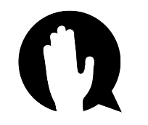
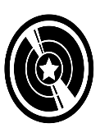
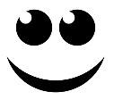
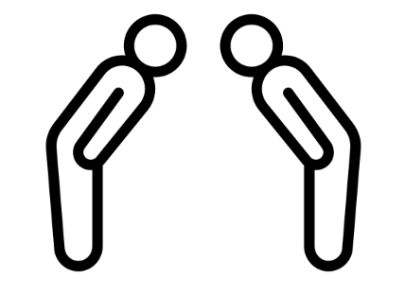


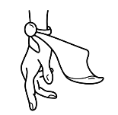

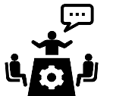


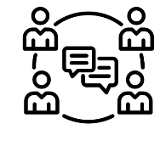

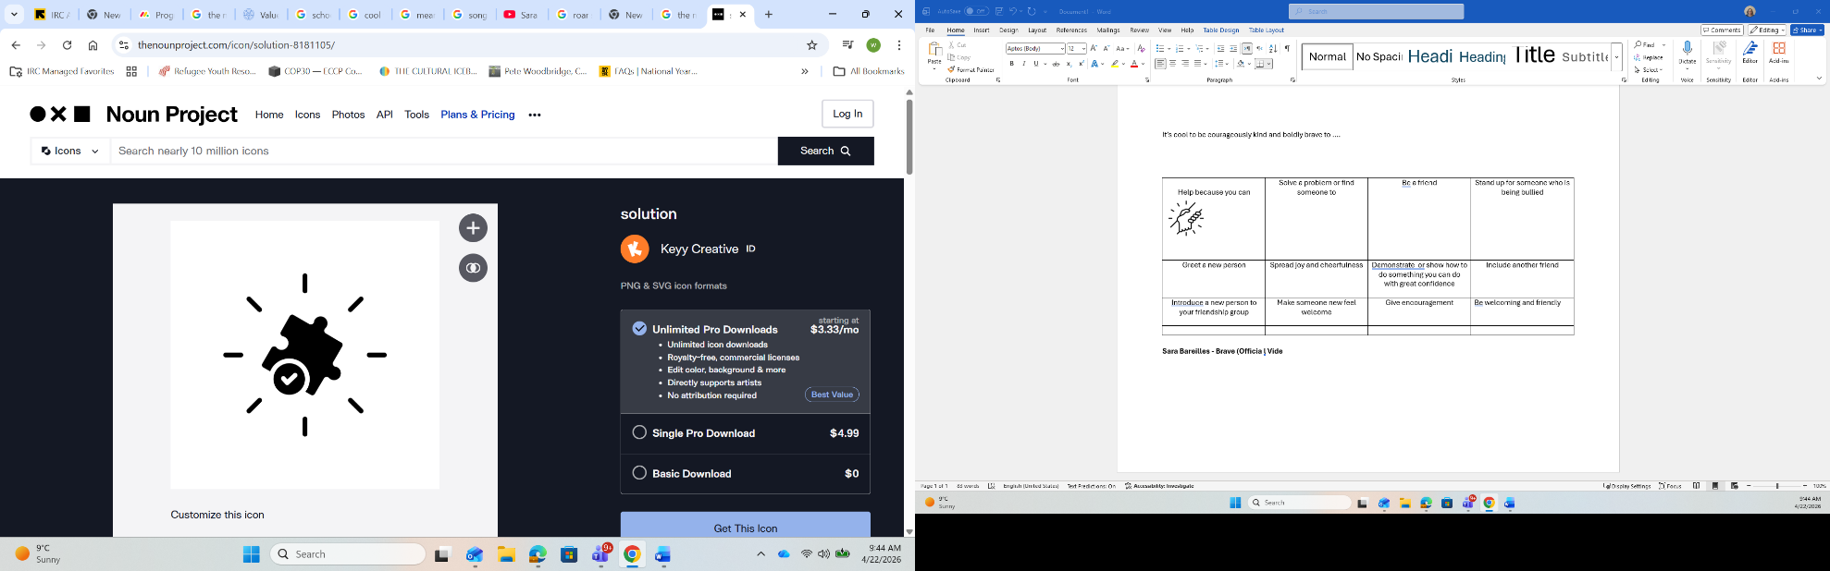
Courageously kind deeds are appreciated by everyone and remembered long after.
Greet others, not only my friends. | Share a smile and make eye contact with others. | Respect differences, choices, decisions + opinions. | Help because you can.
Spread joy and cheerfulness. | Show or explain something carefully and with patience. | Be welcoming and friendly especially to new people in school. | Pair up with someone who needs a partner without being asked.
Introduce a new person to your friendship group. | Stand up for someone who is being bullied or treated unfairly. | Offer support, encouragement + praise to those in need of a boost. | Solve a problem or find an adult who can help.
Think of a time when someone helped you out of the blue.
How did it make you feel?
Notes:
Hand out copies of the ‘Courageously Kind Deeds’ and learners reflect for 5min
They share recollections in pairs or groups discussion for 5 min

Slide 7
Why do you think these courageously kind deeds are important in our school community and wider society?
Greet others, not only my friends. | Share a smile and make eye contact with others. | Respect differences, choices, decisions + opinions of others. | Help because you can.
Spread joy and cheerfulness. | Show or explain something carefully and with patience. | Be welcoming and friendly especially to new people in school. | Pair up with someone who needs a partner without being asked.
Introduce a new person to your friendship group. | Stand up for someone who is being bullied or treated unfairly. | Offer support, encouragement + praise to those in need of a boost. | Solve a problem or find an adult who can help.
Pick the easiest 3
Do we always do these ?
Notes:
Think Individually or discuss in pairs or groups discussion for 5 min

Slide 8






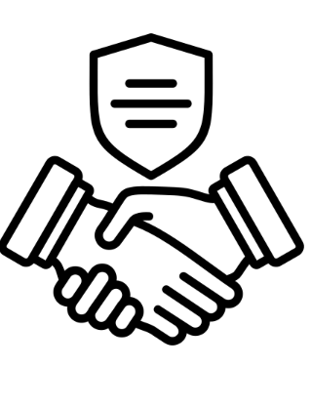
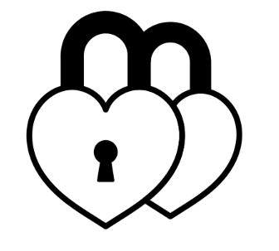
Personal Reflection Time: Use the ‘Courageously Kind Deeds’ Sheet to help you ☺
3 things I find easy to do |  | 1. | 2. | 3.
3 things I could try to be more boldly brave or courageously kind to others.
Think carefully about the reasons or barriers keeping me from doing them.
Record solutions to the barriers discussed in box above.
3 things I pledge to do from the courageous acts list to contribute to a caring, kind and friendly society.
Notes:
Students complete top 3 rows independently.
Then they work in pairs or trios to work out the solutions ( 4th row down)
Students complete row 5 independently for homework and share pledges in pairs/ trios and encourage one another to keep pledges

Slide 9


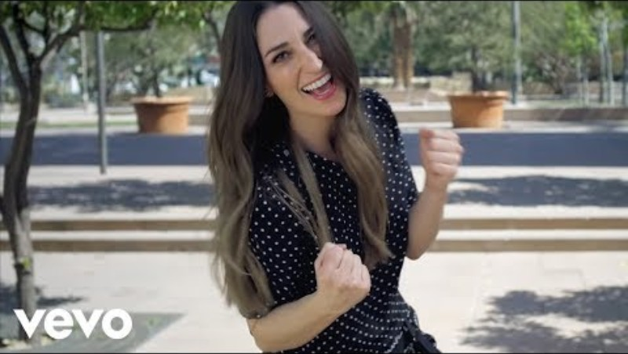

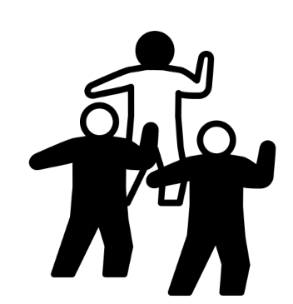

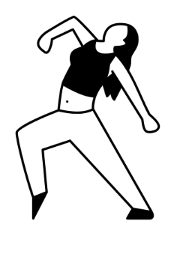

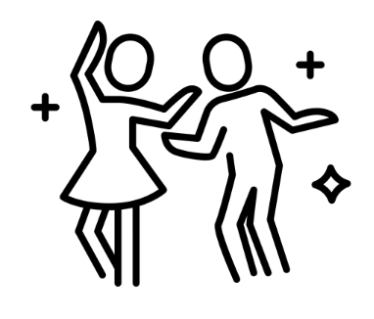

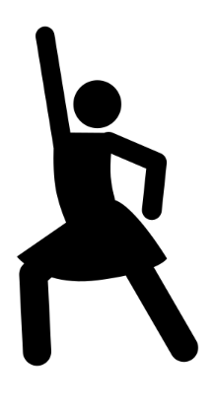

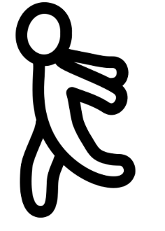

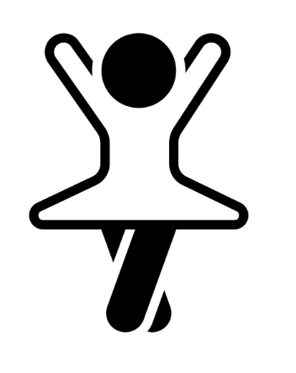
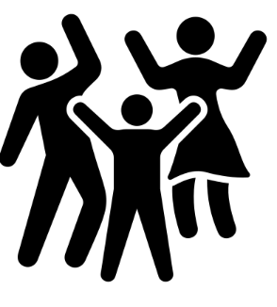
Notes:
Brave - Song by Sara Bareilles
Make up a dance routine – minimum 3 moves
Give the students between 5 to 15 min to prep and work out the routine / synchronization
Groups perform to each other and repeat until they have performed to everyone. OR
They can show to the whole class if they are confident

Slide 10
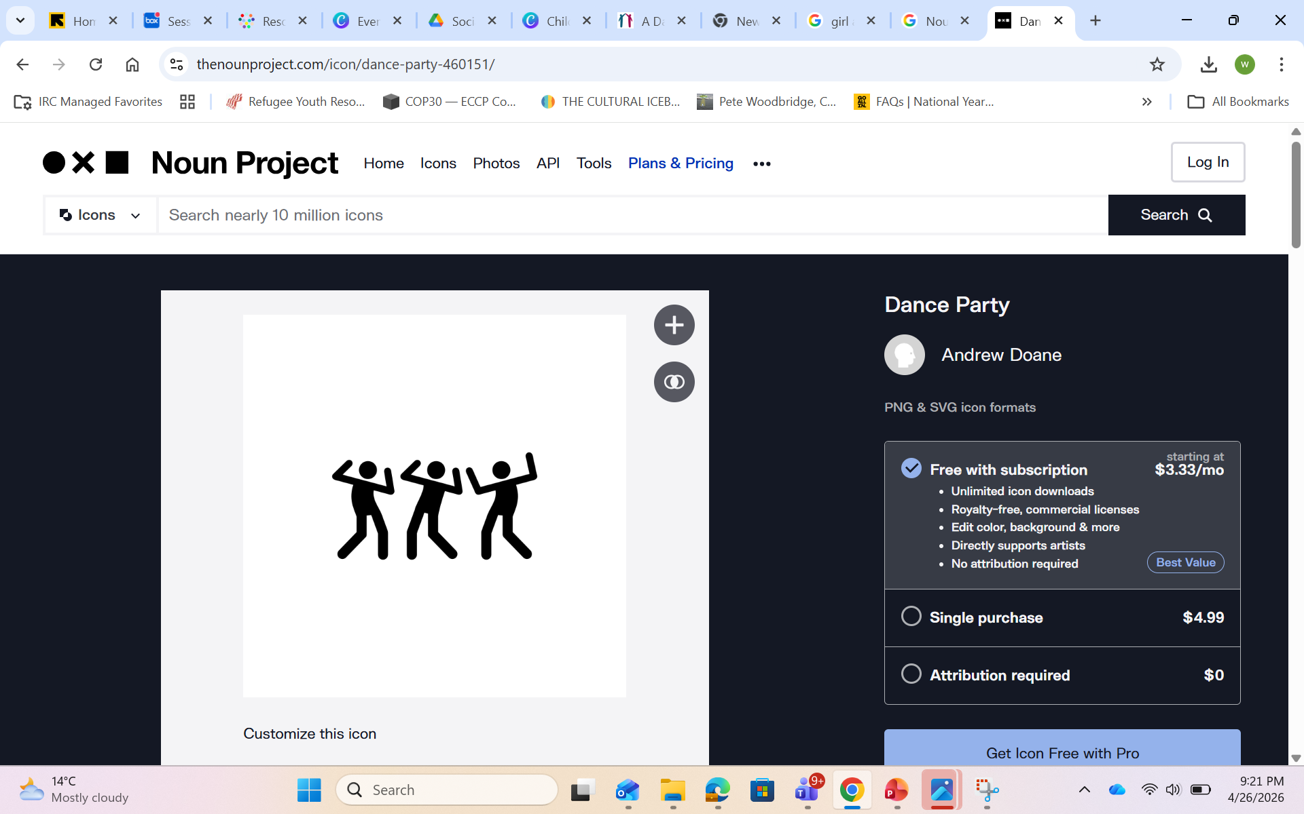
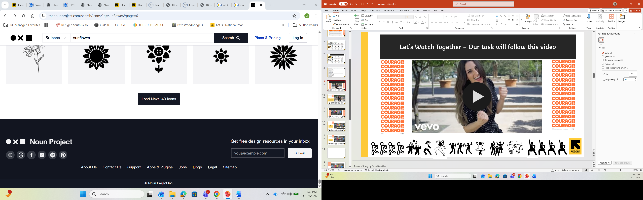
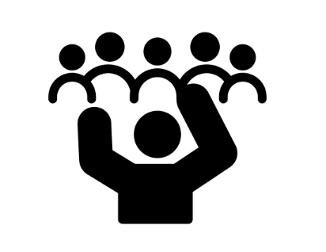
Let’s show our
TASK:
Form a group of 3 to 6 people
Make up a short dance with a minimum of 3 moves
One move or action from each person in the group
Time: 5 - 10 min
Notes:
Brave - Song by Sara Bareilles
Make up a dance routine – minimum 3 moves
Give the students between 10 to 20 min to prep and work out the routine / synchronization
They can perform to each group and rotate until they have performed to all groups. OR
They can show to the whole class if they are confident

Slide 11
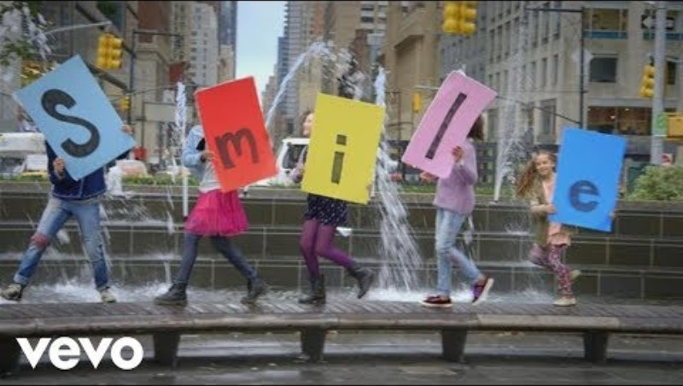

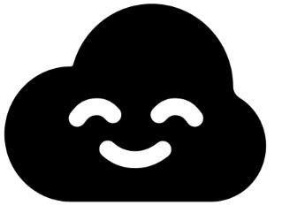
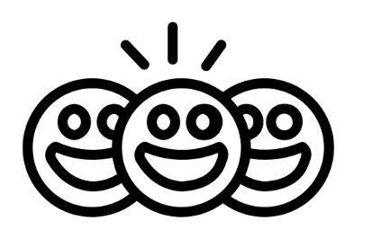



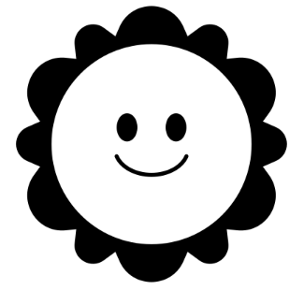
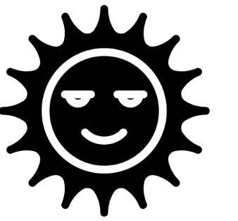

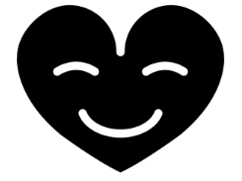

Let’s Watch Together – Our task will follow this video
Notes:
Sia - You're Never Fully Dressed Without a Smile

Slide 12
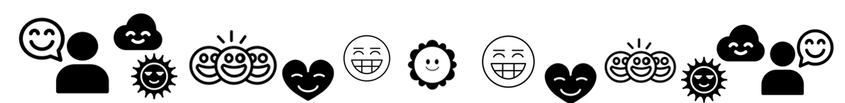
Let’s show our
TASK :
Practice your smile
Make a poster about smiles and include a quote
Notes:
Sia - You're Never Fully Dressed Without a Smile
1.) Practice the art of smiling and share it with others.
2.) Make a poster about smiles and include a quote
3.) Research: Why smiling is good for us? Types of smiles
4.) How Smiling Lowers Stress (NHS/Bupa Context)
Reduced Cortisol & Adrenaline: Smiling lowers levels of cortisol and adrenaline.
Relaxation: Smiles can help us relax.
Improved Immune Function: Smiling boosts the immune system by increasing white blood cell production.
Lower Heart Rate: Smiling can lower blood pressure and heart rate during stressful activities.
Important Distinctions
Dominance Smiles: These are more of a sneer or a smirk, often asymmetrical with a raised eyebrow, meant to show superiority. Unlike other types, these can increase cortisol and heart rates.
Duration: Holding a gentle smile for as little as 10 seconds can have a positive effect
Which country smiles the most = Malaysia

Slide 13
Greet all, not only my friends. | Share a smile and make eye contact with others. | Respect differences, choices, decisions + opinions of others. | Help because you can.
Spread joy and cheerfulness. | Show or explain something carefully and with patience. | Be welcoming and friendly especially to new people in school. | Pair up with someone who needs a partner without being asked.
Introduce a new person to your friendship group. | Stand up for someone who is being bullied or treated unfairly. | Offer support, encouragement + praise to those in need of a boost. | Solve a problem or find an adult who can help.
BEING
Courageously Kind
&
Boldly Brave

